Slide 1

MicrosoftEngage
Algorithms

Slide 2
Introduction of Cinemaos Recommender (web app)
Cinemaos is a movie recommendation web application and as well as movies search web application .
Based on user preferences of language and genre it recommends movies to the user.
We can also directly search the movie names and the actor or cast names .
Here we can see popular and trending movies of a particular day or in the week as well as in theatre or in tv.

Slide 3
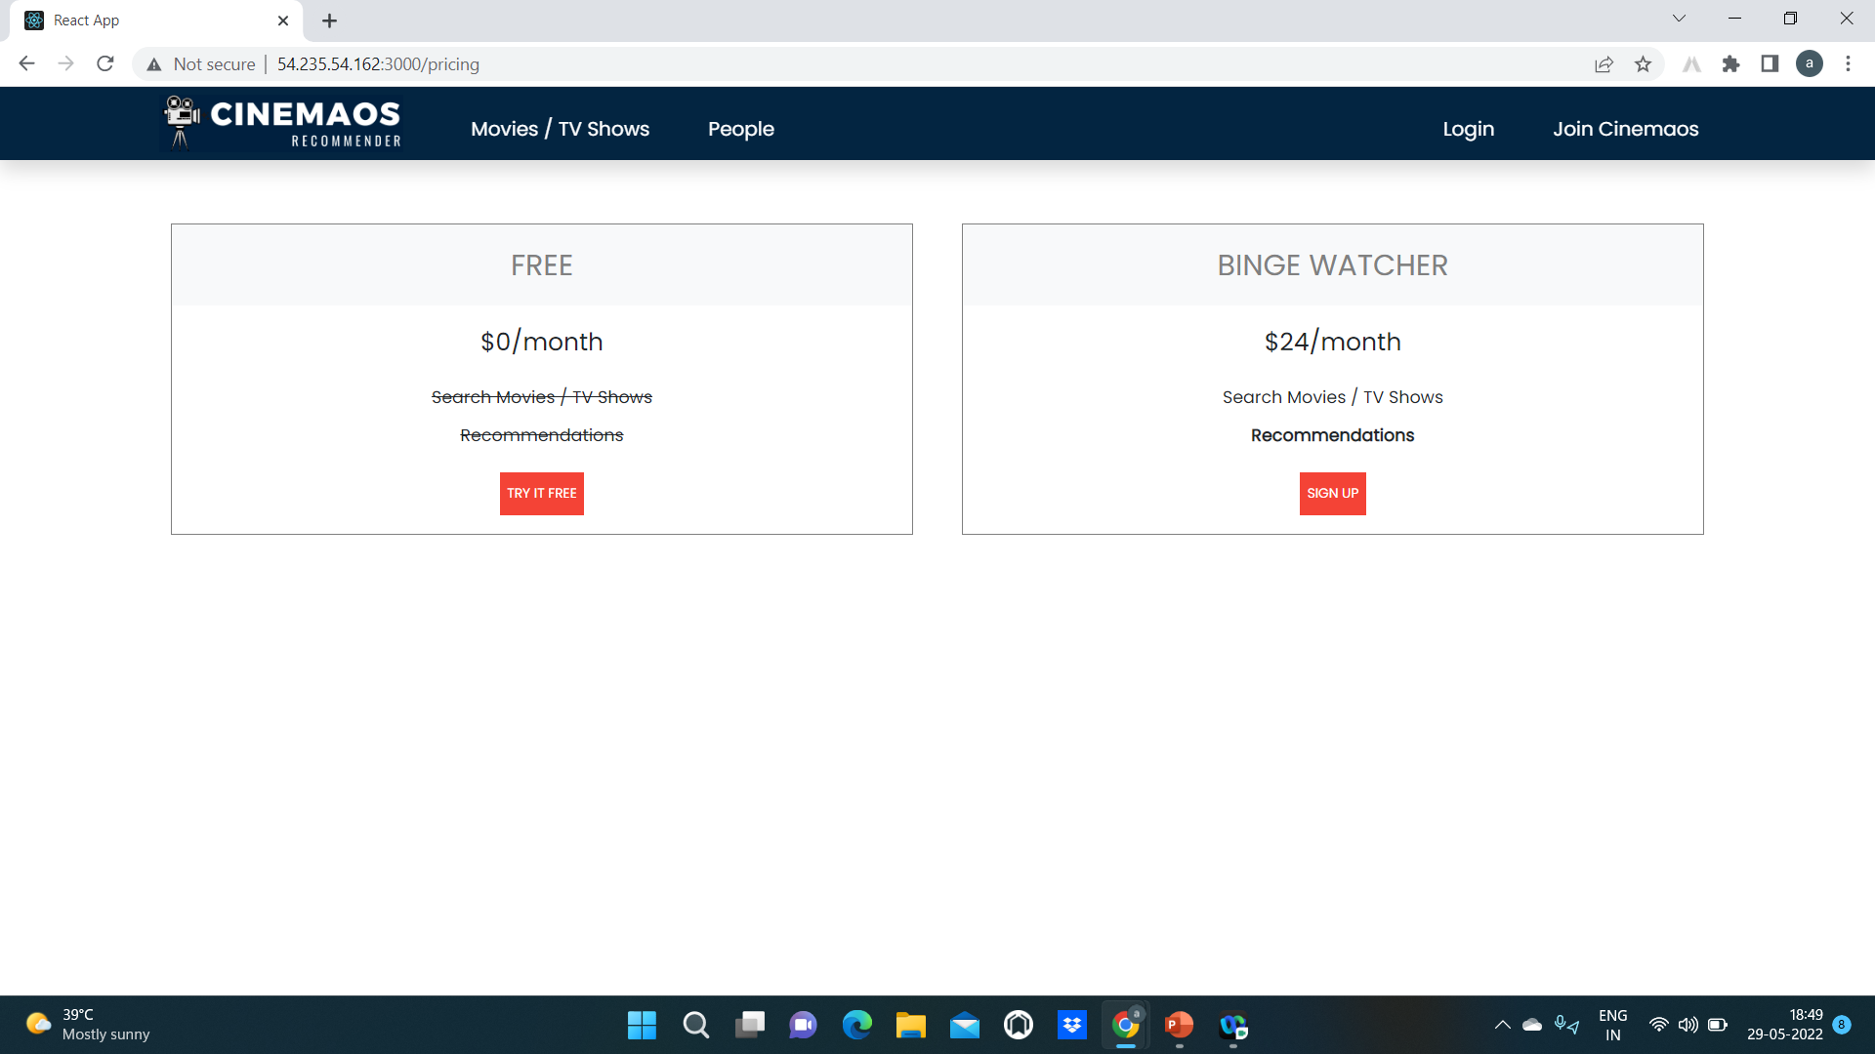
Join Cinemaos

Slide 4
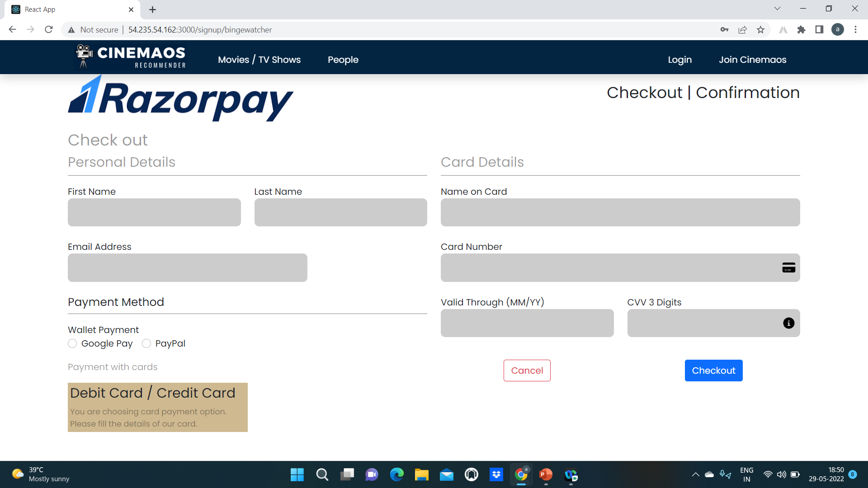
Sample Payment page

Slide 5
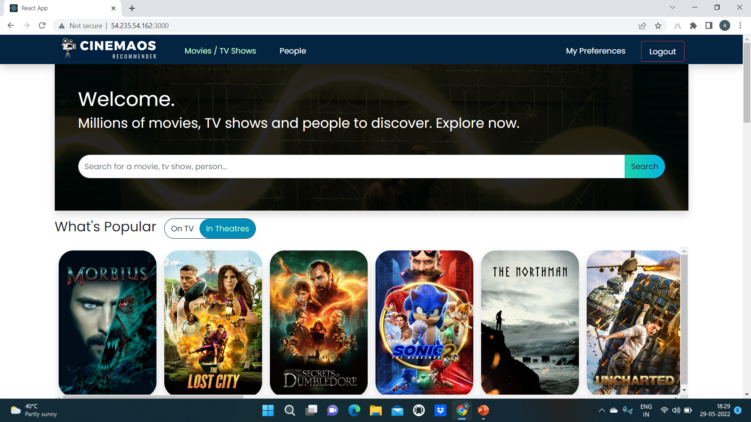
Interface of Cinemaos

Slide 6
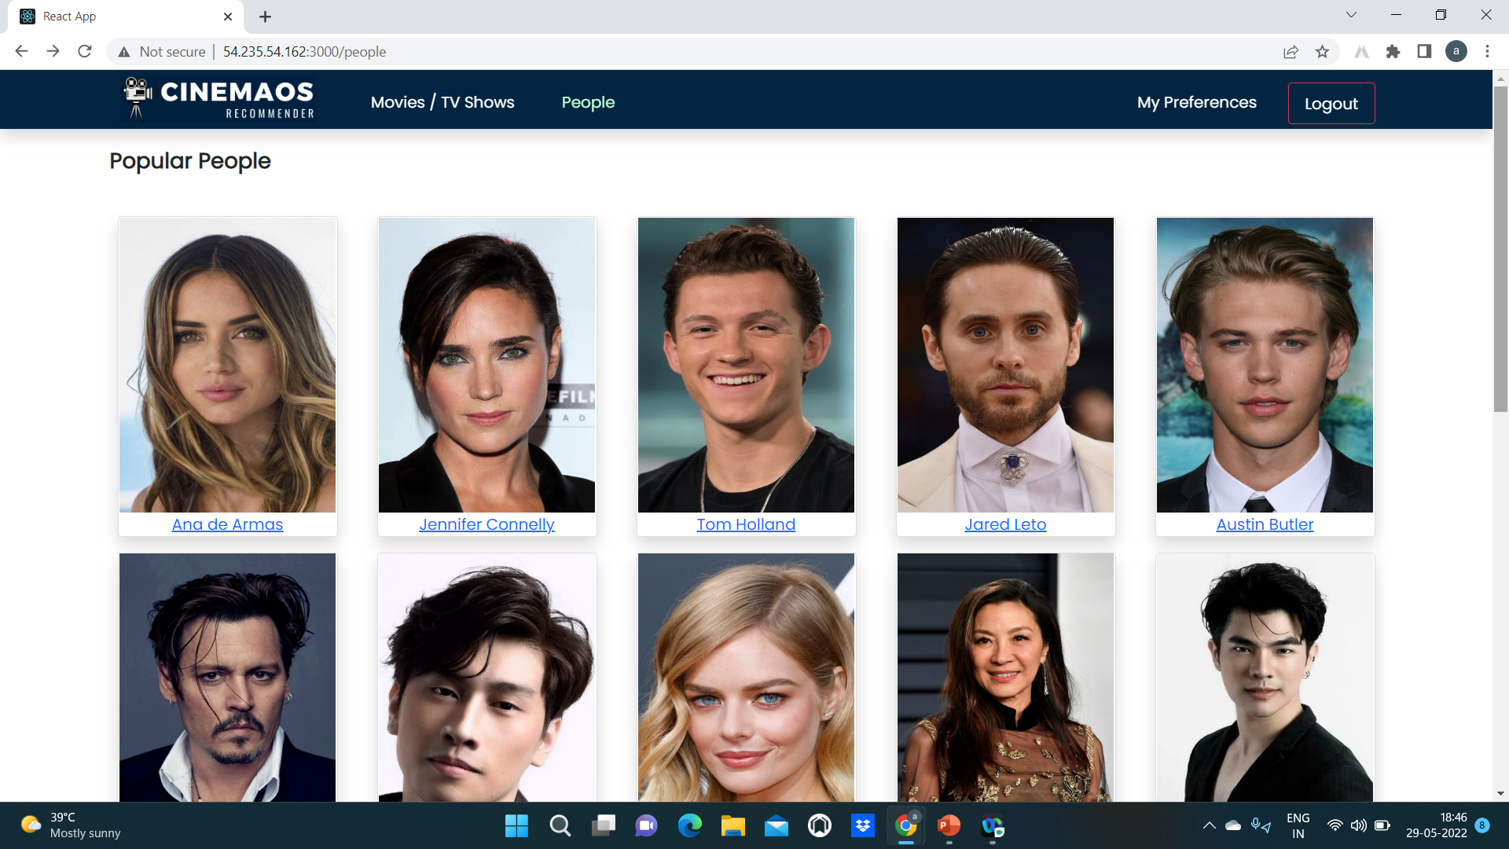
People(cast)

Slide 7
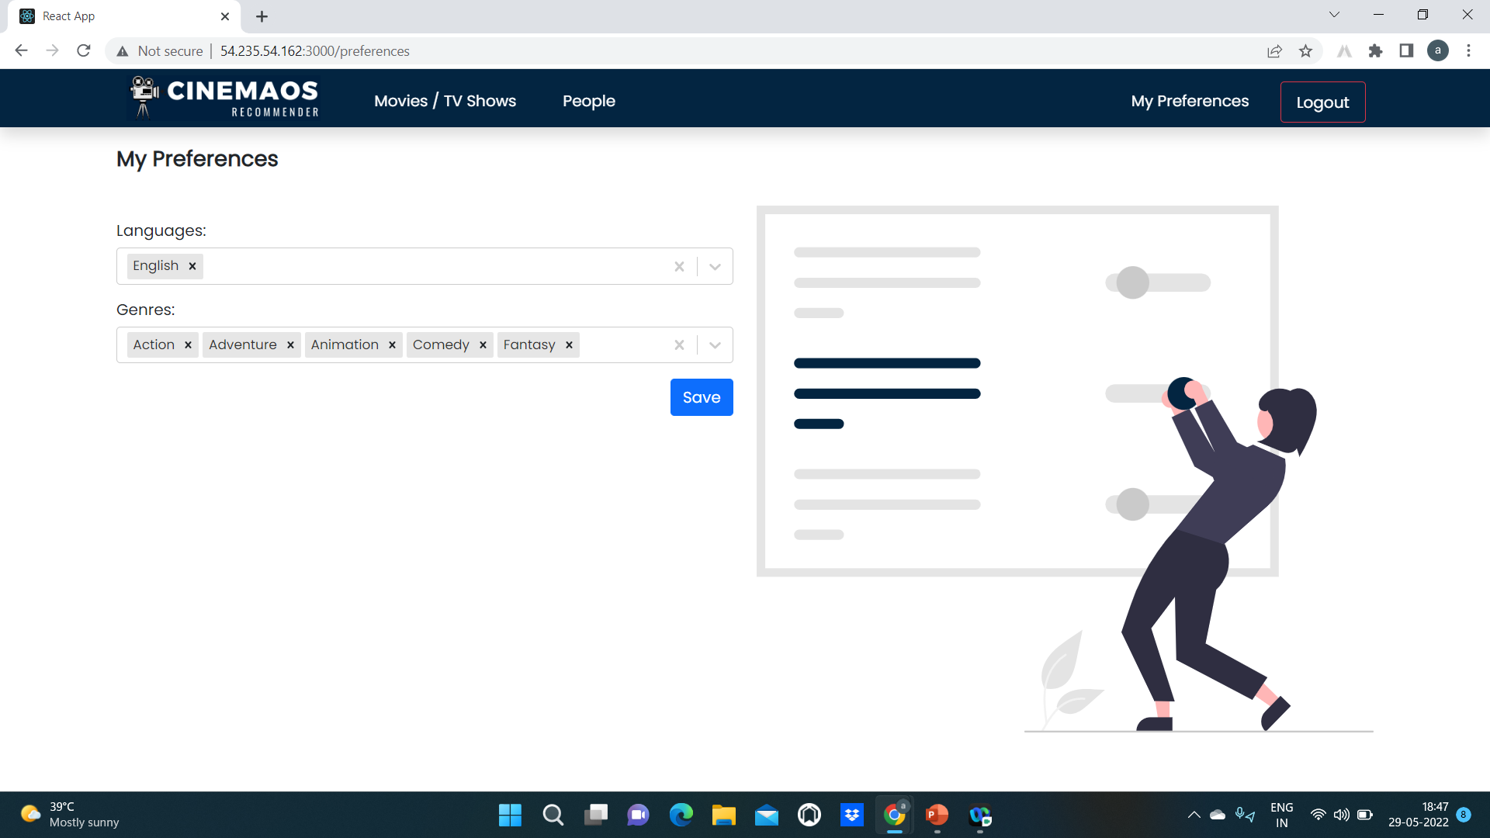
Selecting preferences

Slide 8
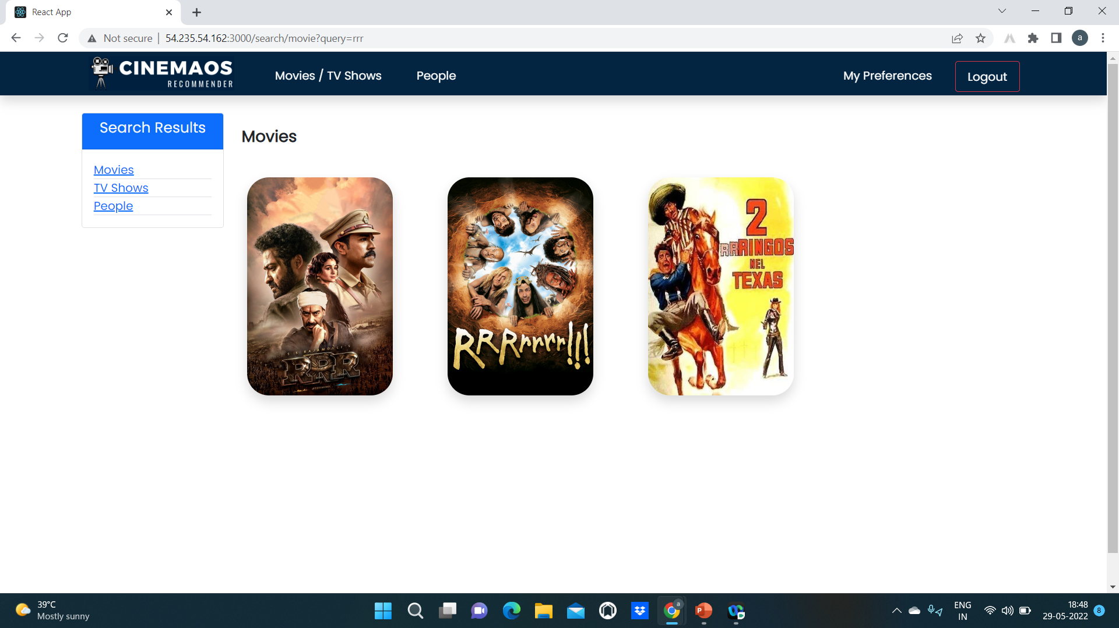
Search results

Slide 9
ThankYou

